Slide 1
LECTURE FOUR ASSIGNING COSTS TO PRODUCTS
©2020 McGraw-Hill Education. All rights reserved. Authorized only for instructor use in the classroom. No reproduction or further distribution permitted without the prior written consent of McGraw-Hill Education.

Slide 2
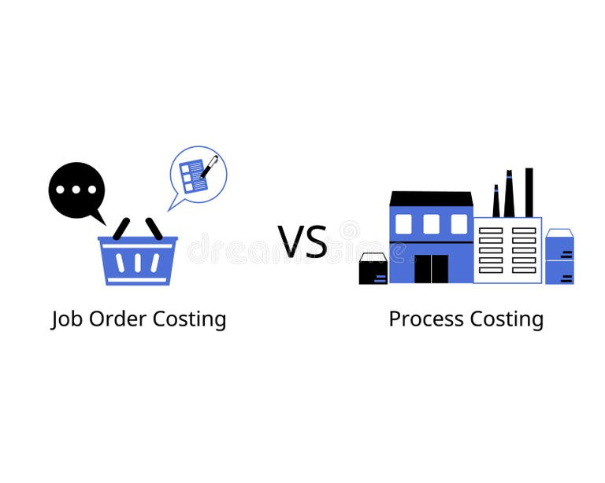
Two Cost Accounting Systems
Custom, unique jobs
Production by order
Low Volume
Low Standardization
E.g. Customized furniture & Car manufacturing companies
Continuous, identical units
Mass production
High Volume
High Standardization
E.g.: Paper manufacturing company
Water bottle manufacturing

Slide 3
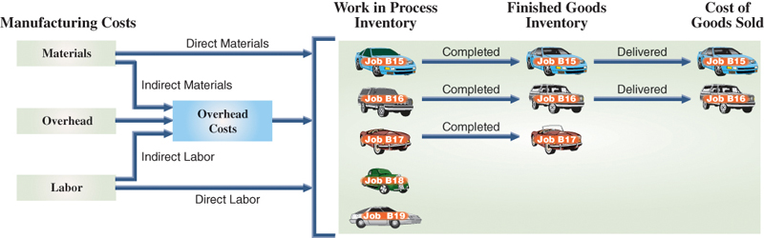
Job-Order Costing ( Production Cost Flow)
Example: Car Manufacturing Company:

Slide 4
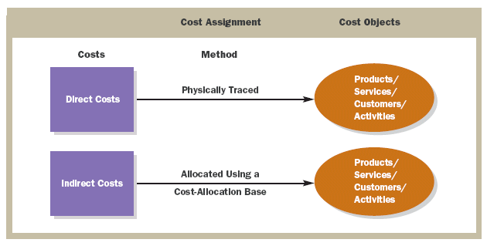
Cost Assignment
Direct costs are physically traced to
a cost object. Indirect costs are allocated
using a cost-allocation base.
Notes:
Direct costs are physically traced to a cost object. Indirect costs are allocated using a cost-allocation base.

Slide 5
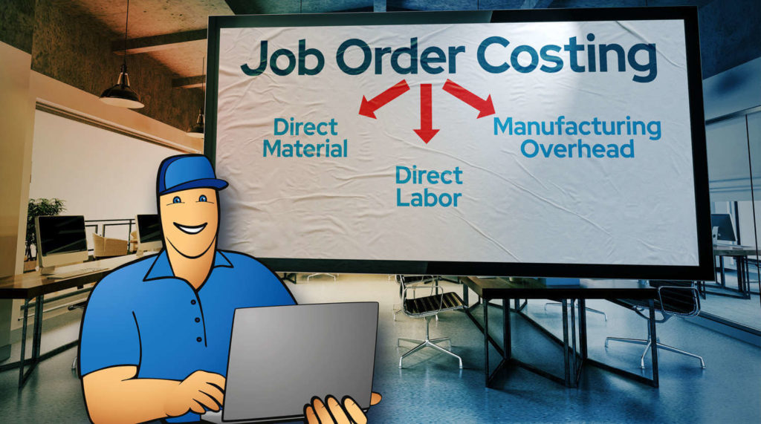
Components of Manufacturing Cost
Direct Materials (DM): raw inputs used in production (Traceable for each job order)
Direct Labor (DL): wages of production workers ( Traceable for each job order)
Manufacturing Overhead (MOH): indirect costs (rent, depreciation, etc.) ( Not Traceable for each job order !!) because it is shared across all jobs.

Slide 6
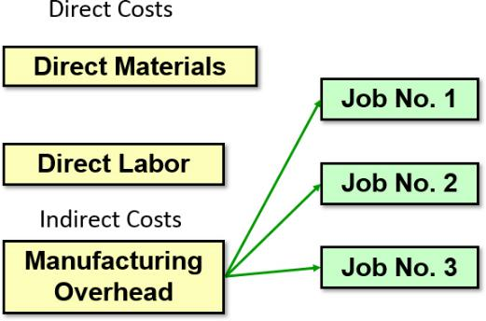
Job-Order Costing – Cost Flow 2
Manufacturing Overhead, including indirect materials and indirect labor, are allocated to all jobs rather than directly traced to each job.

Slide 7
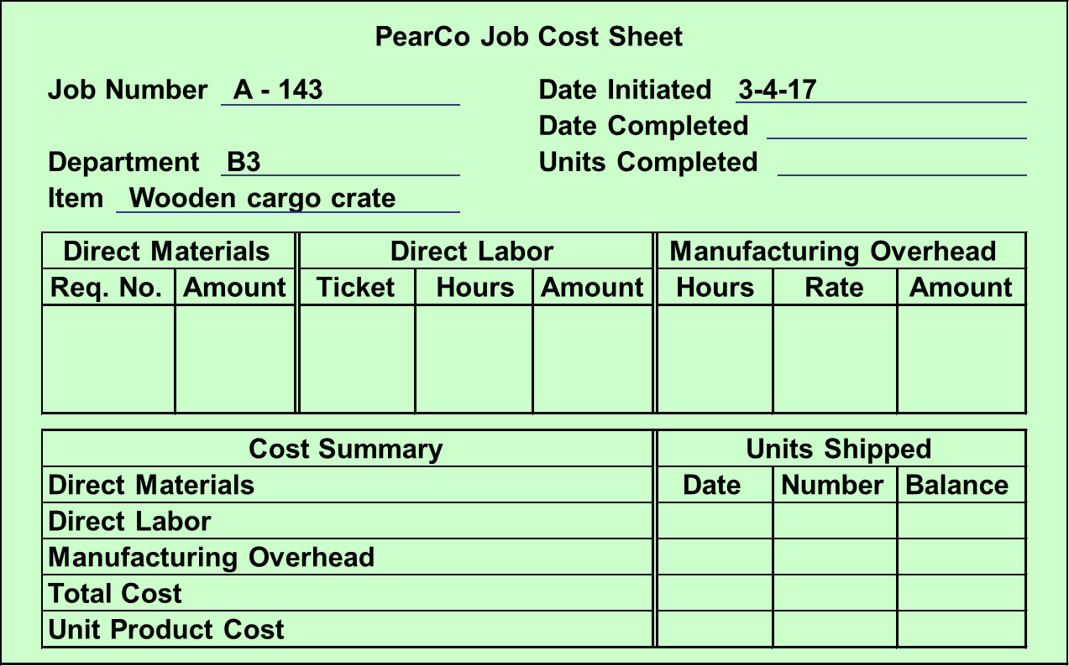
The Job Cost Sheet
Access the text alternative for slide images.

Slide 8
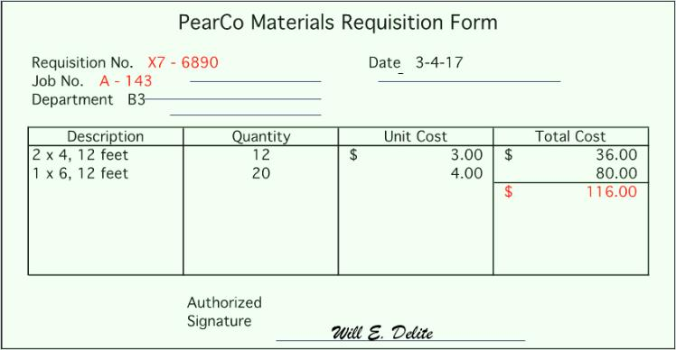
Measuring Direct Materials Cost – Part 1
Access the text alternative for slide images.

Slide 9
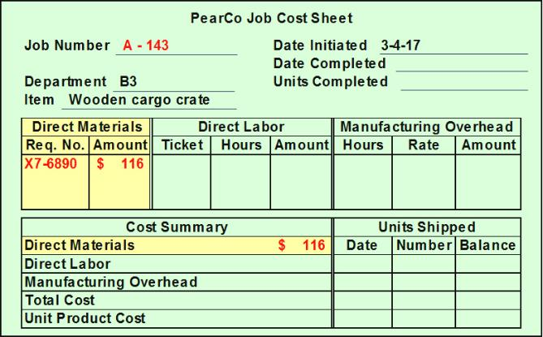
Measuring Direct Materials Cost – Part 2

Slide 10
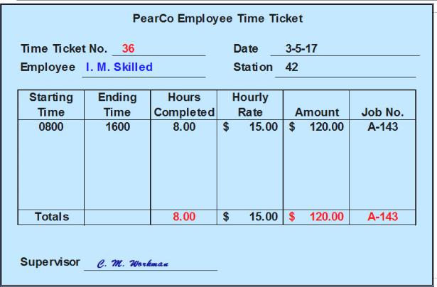
Measuring Direct Labor Costs
Access the text alternative for slide images.

Slide 11
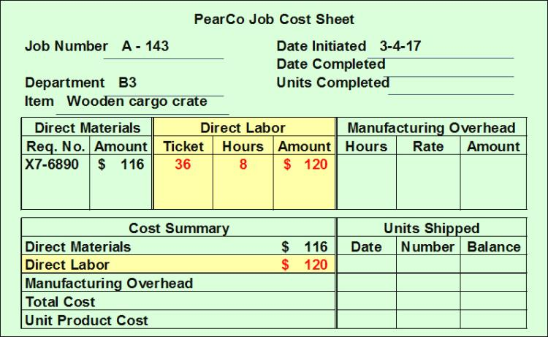
Job-Order Cost Accounting

Slide 12
Learning Objective 1
Compute a predetermined overhead rate.

Slide 13
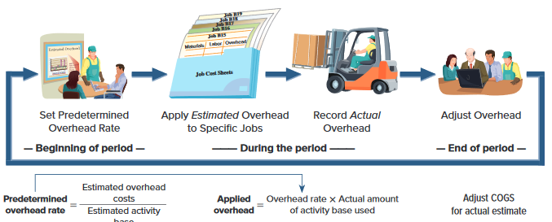
Overhead Costs
Exhibit 19.11
Access the text alternative for slide images.
Learning Objective P3: Describe and record the flow of overhead costs in job order costing.
Notes:
We turn now to overhead costs. Unlike direct materials and direct labor, actual overhead costs are not traced directly to individual jobs. Still, each job’s total cost must include estimated overhead costs. The accounting for overhead costs follows the four-step process shown in this slide. Overhead accounting requires managers to first estimate what total overhead costs will be for the coming period. We cannot wait until the end of a period to allocate overhead to jobs, because managers’ decisions require up-to-date costs. This estimated overhead cost, even if it is not exactly precise, is needed to estimate a job’s total costs before its completion. Such estimated costs are useful for managers in many decisions, including setting prices and identifying costs that are out of control. At the end of the year, the company adjusts its estimated overhead to the actual amount of overhead incurred for that year, and then considers whether to change its predetermined overhead rate for the next year.

Slide 14
Why Use an Allocation Base?
An allocation base, such as direct labor hours, direct labor dollars, or machine hours, is used to assign manufacturing overhead to individual jobs.
We use an allocation base because:
a. It is impossible or difficult to trace overhead costs to particular jobs.
b. Manufacturing overhead consists of many different items ranging from the grease used in machines to the production manager’s salary.
c. Many types of manufacturing overhead costs are fixed even though output fluctuates during the period.

Slide 15
Application of Factory Overhead)
The predetermined factory overhead (OH) rate used to apply overhead to jobs is determined before the period begins.
Estimated factory overhead amount for the year
OH Rate =
Estimated level of cost driver for the year
Some Possible Cost Drivers:
1. direct labor-hours
2. machine-hours
3. number of set-ups
4. number of orders
5. manufacturing cycle-time
The OH rate can be
calculated on a
plantwide or a
departmental basis.
4-15
Notes:
$1000,000/ 100,000DL hrs= $10/Dlhrs
DM……
DLC 50X$20/hr =1000
Oh 50 x 10 500

Slide 16
Application of Factory Overhead (continued)
Predetermined factory overhead amount for the year
OH Rate =
Predetermined level of cost driver for the year
Overhead applied = OH Rate × Actual activity
Based on estimates, and determined before the period begins
Actual amount of the allocation base, such as direct labor-hours, incurred during the period
4-16

Slide 17
The Need for a POHR
Predetermined overhead rates that rely upon estimated data are often used because:
Actual overhead for the period is not known until the end of the period, thus inhibiting the ability to estimate job costs during the period.
Actual overhead costs can fluctuate seasonally, thus misleading decision makers.

Slide 18
Learning Objective 2
Apply overhead cost to jobs using a predetermined overhead rate.

Slide 19
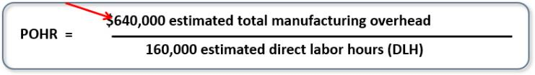
Overhead Application Rate
POHR = $4.00 per direct labor-hour

Slide 20
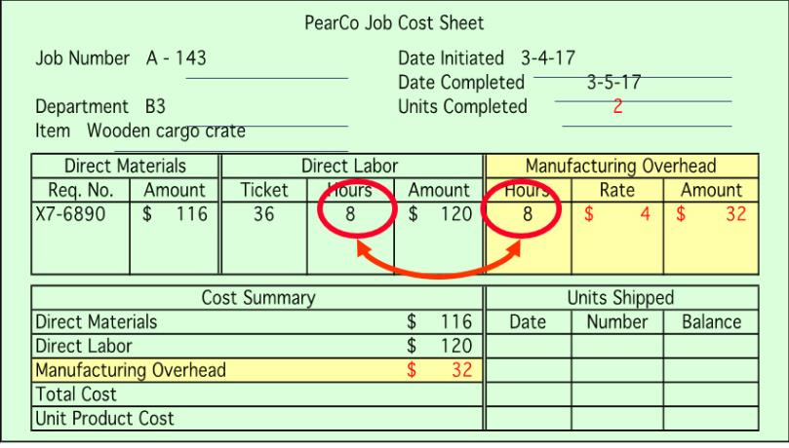
Recording Manufacturing Overhead

Slide 21
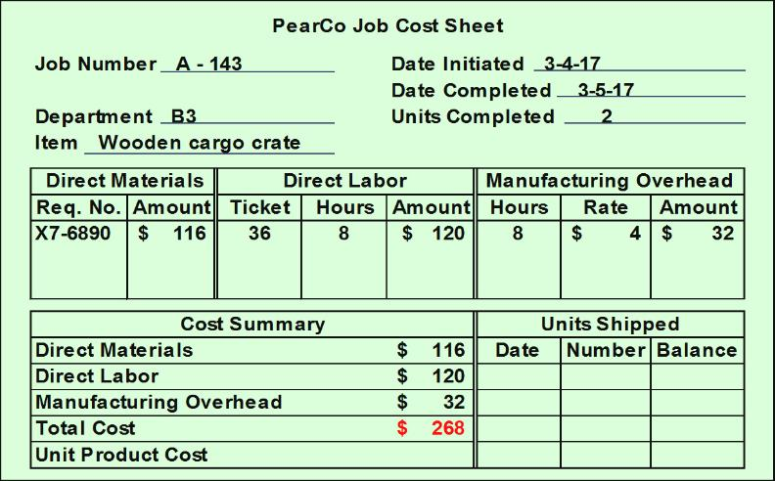
Calculating Total Cost of Job

Slide 22
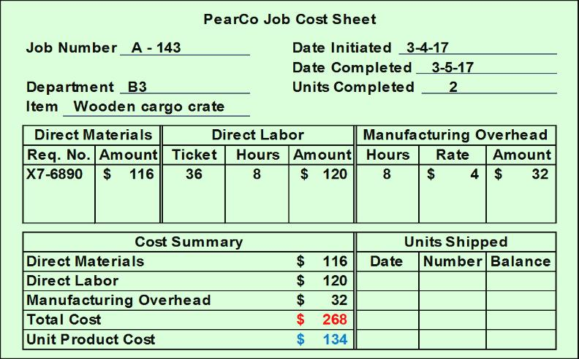
Calculating Unit Product Cost

Slide 23
Quick Check 1
Job WR53 at NW Fab, Inc. required $200 of direct materials and 10 direct labor hours at $15 per hour. Estimated total overhead for the year was $760,000 and estimated direct labor hours were 20,000. What would be recorded as the cost of job WR53?
a. $200.
b. $350.
c. $380.
d. $730.
Notes:
POHR=760000/20000=$38/DLh
DM= 200
DL=150
Applied OH= 38 x10=380

Slide 24
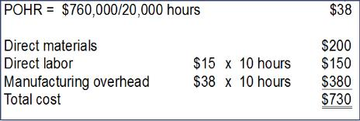
Quick Check 1a
Job WR53 at NW Fab, Inc. required $200 of direct materials and 10 direct labor hours at $15 per hour. Estimated total overhead for the year was $760,000 and estimated direct labor hours were 20,000. What would be recorded as the cost of job WR53?
a. $200.
b. $350.
c. $380.
d. Answer: $730.
Access the text alternative for slide images.

Slide 25
Job-Order Costing – A Managerial Perspective – Part 1
Inaccurately assigning manufacturing costs to jobs adversely influences planning and decisions made by managers.
Job-order costing systems can accurately trace direct materials and direct labor costs to jobs.
Job-order costing systems often fail to accurately allocate the manufacturing overhead costs used during the production process to their respective jobs.

Slide 26
Job-Order Costing – A Managerial Perspective – Part 2
Choosing an Allocation Base
Job-order costing systems often use allocation bases that do not reflect how jobs actually use overhead resources. The allocation base in the predetermined overhead rate must drive the overhead cost to improve job cost accuracy. A cost driver is a factor that causes overhead costs.
Many companies use a single predetermined plantwide overhead rate to allocate all manufacturing overhead costs to jobs based on their usage of direct-labor hours.
It is often overly simplistic and incorrect to assume that direct-labor hours is a company’s only manufacturing overhead cost driver.
If more than one overhead cost driver can be identified, job cost accuracy is improved by using multiple predetermined overhead rates.

Slide 27
Job-Order Costing for Financial Statements to External Parties
The amount of overhead applied to all jobs during a period will differ from the actual amount of overhead costs incurred during the period.
When a company applies less overhead to production than it actually incurs, it creates what is known as underapplied overhead.
When it applies more overhead to production than it actually incurs, it results in overapplied overhead.
Notes:
Sales 1000,0000
Beginning Finished inventory 100,000 given
+ Cost of goods manufactured 200,000 { DM 50,000+ DL50000 + Allocated OH100,000} >actual by 5000
Cost of goods available for sale 300,000
Ending inv ( 50,000)
CoGS 250,000
Actual OH 100,000
Sales 1000,000
-CoGS 250,000 260,000
Gross Profit 750000 740,000
DM /DL / OH

Slide 28
Financial Adjust for Overhead Applied
The cost of goods sold reported on a company’s income statement must be adjusted to reflect underapplied or overapplied overhead.
The adjustment for underapplied overhead increases cost of goods sold and decreases net operating income.
The adjustment for overapplied overhead decreases cost of goods sold and increases net operating income.
Notes:
Sales
-COGS
Gross Profit

Slide 29
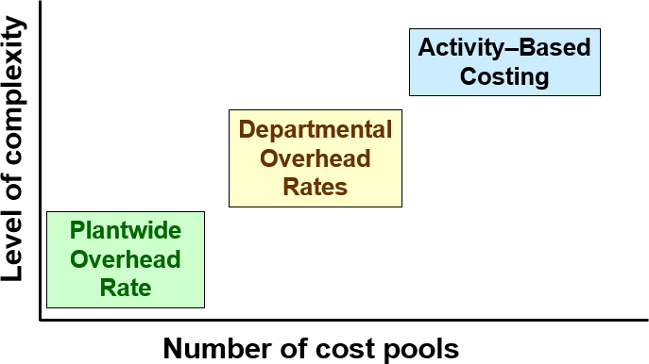
Types of Overhead application rates
ABC differs from traditional cost accounting because numerous overhead cost pools are used.
Access the text alternative for slide images.

Slide 30
Multiple Predetermined Overhead Rates—An Activity-Based Approach
When a company creates overhead rates based on the activities that it performs, it is employing an approach called activity-based costing.
Activity-based costing is an alternative approach to developing multiple predetermined overhead rates. Managers use activity-based costing systems to more accurately measure the demands that jobs, products, customers, and other cost objects make on overhead resources.

Slide 31
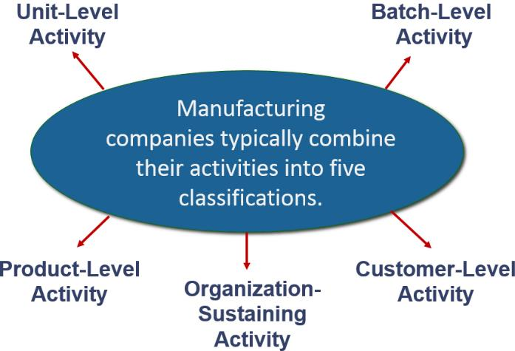
Key Definitions and Concepts

Slide 32
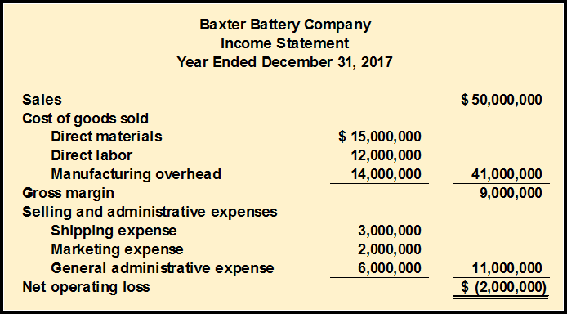
The Five Steps for Implementing ABC
The company makes two types of automobile batteries—SureStart (a standard battery) and LongLife (a deluxe battery). Baxter reported its first loss ever.
Access the text alternative for slide images.

Slide 33
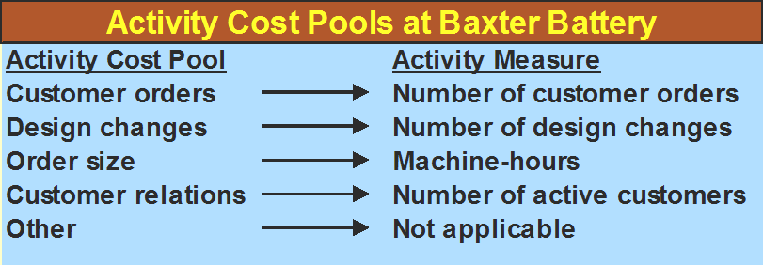
Define Activities, Activity Cost Pools, and Activity Measures
At Baxter Battery, the ABC team selected the following activity cost pools and activity measures:
Access the text alternative for slide images.

Slide 34
Define Activities, Activity Cost Pools, and Activity Measures – Part 2
Customer Orders - assigned all costs of resources that are consumed by taking and processing customer orders.
Design Changes - assigned all costs of resources consumed by customer requested design changes.
Order Size - assigned all costs of resources consumed as a consequence of the number of units produced.
Customer Relations - assigned all costs associated with maintaining relations with customers.
Other - assigned all organization-sustaining costs and unused capacity costs.

Slide 35
Assign costs to cost pools using a first-stage allocation.

Slide 36
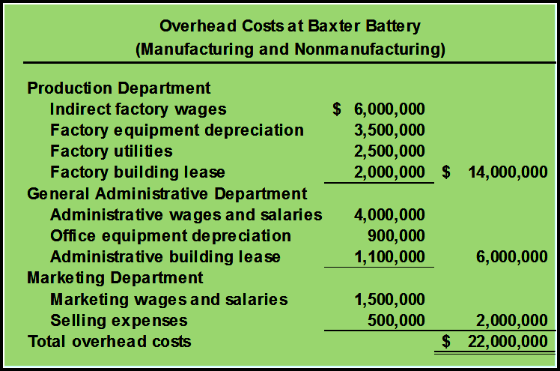
Assign Overhead Costs to Activity Cost Pools –
Direct materials, direct labor, and shipping are excluded because Baxter Battery’s existing cost system can directly trace these costs to products or customer orders.

Slide 37
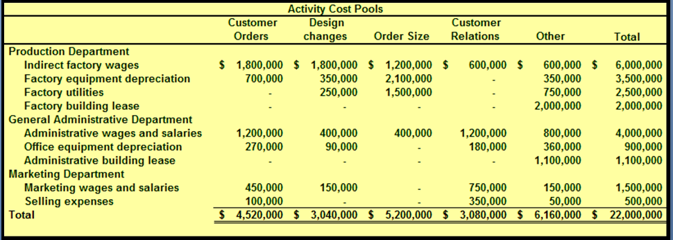
Assign Overhead Costs to Activity Cost Pools

Slide 38
Compute activity rates for cost pools.

Slide 39
Calculate Activity Rates
The ABC team determines that Baxter Battery will have these total activities for each activity cost pool:
10,000 customer orders,
4,000 design changes,
800,000 machine-hours,
2,000 customers served.
Now the team can compute the individual activity rates by dividing the total cost for each activity by the total activity levels.

Slide 40
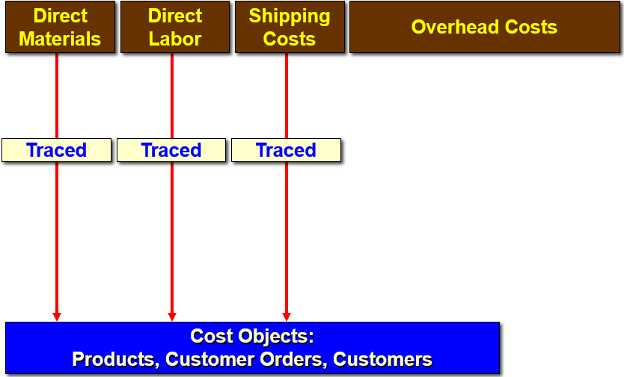
Calculate Activity Rates

Slide 41
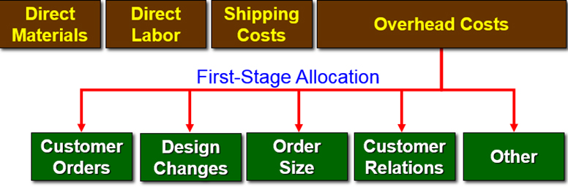
Calculate Activity Rates
Cost Objects:
Products, Customer Orders, Customers

Slide 42
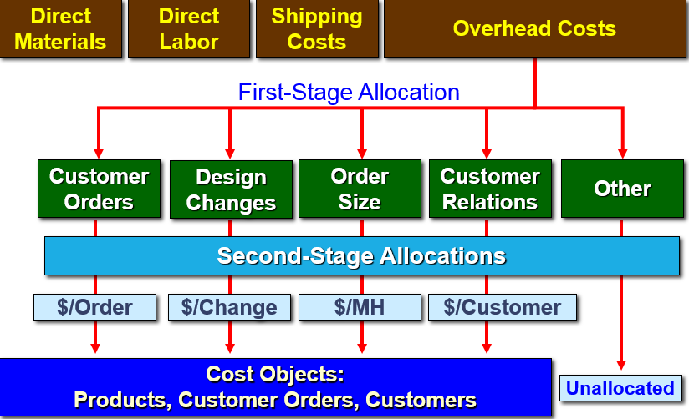
Calculate Activity Rates
Access the text alternative for slide images.

Slide 43
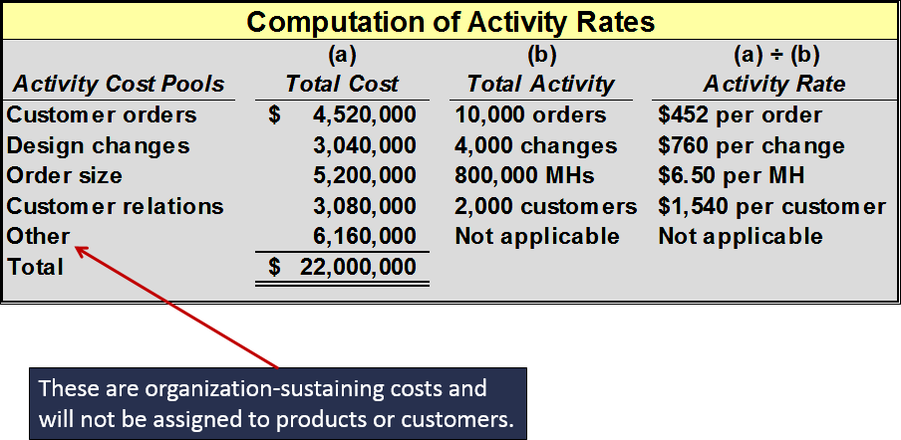
Calculate Activity Rates
Access the text alternative for slide images.

Slide 44
Assigning Overhead to Products
Baxter Battery Information
SureStart
Requires no new design resources.
800,000 batteries ordered with 4,000 separate orders.
Each SureStart requires 36 minutes of machine time for a total of 480,000 machine-hours.
LongLife
Requires new design resources.
400,000 batteries ordered with 6,000 separate orders.
4,000 custom designs prepared.
Each LongLife requires 48 minutes of machine time for a total of 320,000 machine-hours.

Slide 45
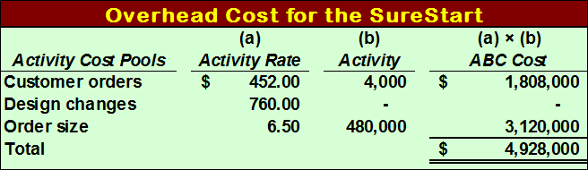
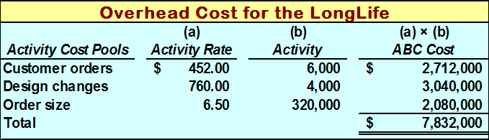
Assigning Overhead to Products
$4,928,000 + $7,832,000 + $9,240,000 (not assigned) = $22,000,000
Access the text alternative for slide images.

Slide 46
Use activity-based costing to compute product and customer margins.

Slide 47
Prepare Management Reports
Product Margin Calculations
The first step in computing product margins is to gather each product’s sales and direct cost data.
Blank | SureStarts | LongLifes | Total
Sales | $ 31,300,000 | $ 18,700,000 | $ 50,000,000
Direct costs
Direct material | 9,000,000 | 6,000,000 | 15,000,000
Direct labor | 7,000,000 | 5,000,000 | 12,000,000
Shipping | 2,000,000 | 1,000,000 | 3,000,000

Slide 48
Prepare Management Reports
Product Margin Calculations
The second step in computing product margins is to incorporate the previously computed activity-based cost assignments pertaining to each product.
Blank | SureStarts | LongLifes | Total
Sales | $ 31,300,000 | $ 18,700,000 | $ 50,000,000
Direct costs | Blank | Blank | Blank
Direct material | 9,000,000 | 6,000,000 | 15,000,000
Direct labor | 7,000,000 | 5,000,000 | 12,000,000
Shipping | 2,000,000 | 1,000,000 | 3,000,000
ABC cost assignments | Blank | Blank | Blank
Customer orders | 1,808,000 | 2,712,000 | 4,520,000
Design changes | Blank | 3,040,000 | 3,040,000
Order size | 3,120,000 | 2,080,000 | 5,200,000

Slide 49
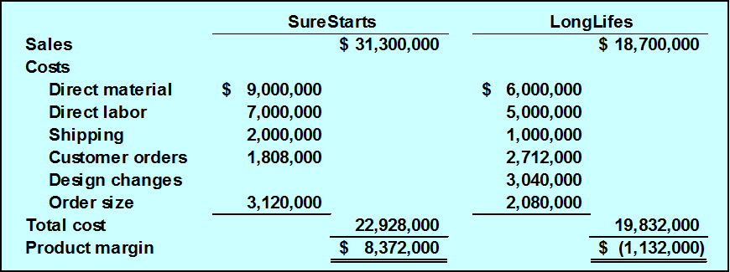
Prepare Management Reports
Product Margin Calculations
The third step in computing product margins is to deduct each product’s direct and indirect costs from sales.

Slide 50
Prepare Management Reports
Product Margin Calculations
The product margins can be reconciled with the company’s net operating income as follows:
Blank | SureStarts | LongLifes | Total
Sales | $ 31,300,000 | $ 18,700,000 | $ 50,000,000
Total costs | 22,928,000 | 19,832,000 | 42,760,000
Product margins | $ 8,372,000 | $ (1,132,000) | $ 7,240,000
Less costs not assigned to products: | Blank | Blank | Blank
Customer relations | Blank | Blank | 3,080,000
Other | Blank | Blank | 6,160,000
Total | Blank | Blank | 9,240,000
Net operating loss | Blank | Blank | $ (2,000,000)

Slide 51
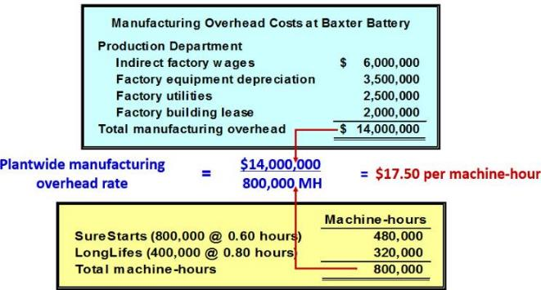
Product Margins Computed Using the Traditional Cost System
The second step in computing product margins is to compute the plantwide overhead rate.
Access the text alternative for slide images.

Slide 52
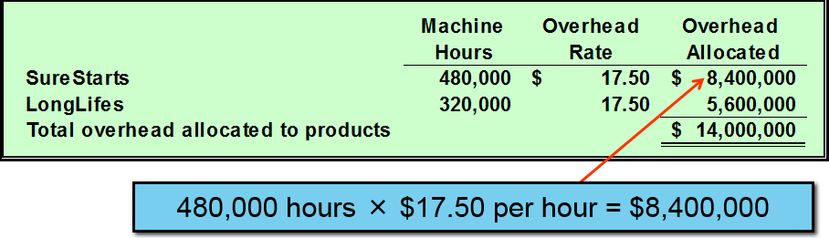
Product Margins Computed Using the Traditional Cost System
The third step in computing product margins is to allocate manufacturing overhead to each product.
Access the text alternative for slide images.

Slide 53
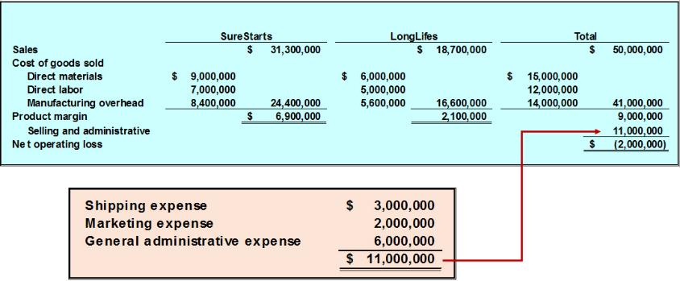
Product Margins Computed Using the Traditional Cost System
The fourth step is to actually compute the product margins.
Access the text alternative for slide images.

Slide 54
Differences Between ABC and Traditional Product Costs
Blank | SureStarts | LongLifes
Product margins - traditional | $ 6,900,000 | $ 2,100,000
Product margins - ABC | 8,372,000 | (1,132,000)
Change in reported margins | $ 1,472,000 | $ (3,232,000)
The traditional cost system overcosts the Sure Starts and reports a lower product margin for this product.
The traditional cost system undercosts the LongLifes and reports a higher product margin for this product.

Slide 55
Differences Between ABC and Traditional Product Costs
There are three reasons why the reported product margins for the two costing systems differ from one another.
1-Traditional costing allocates all manufacturing overhead to products. ABC costing only assigns manufacturing overhead costs consumed by products to those products.

Slide 56
Differences Between ABC and Traditional Product Costs
2-Traditional costing allocates all manufacturing overhead costs using a volume-related allocation base. ABC costing also uses non-volume related allocation bases.
3-Traditional costing disregards selling and administrative expenses because they are assumed to be period expenses. ABC costing directly traces shipping costs to products and includes nonmanufacturing overhead costs caused by products in the activity cost pools that are assigned to products.

